Slide 1
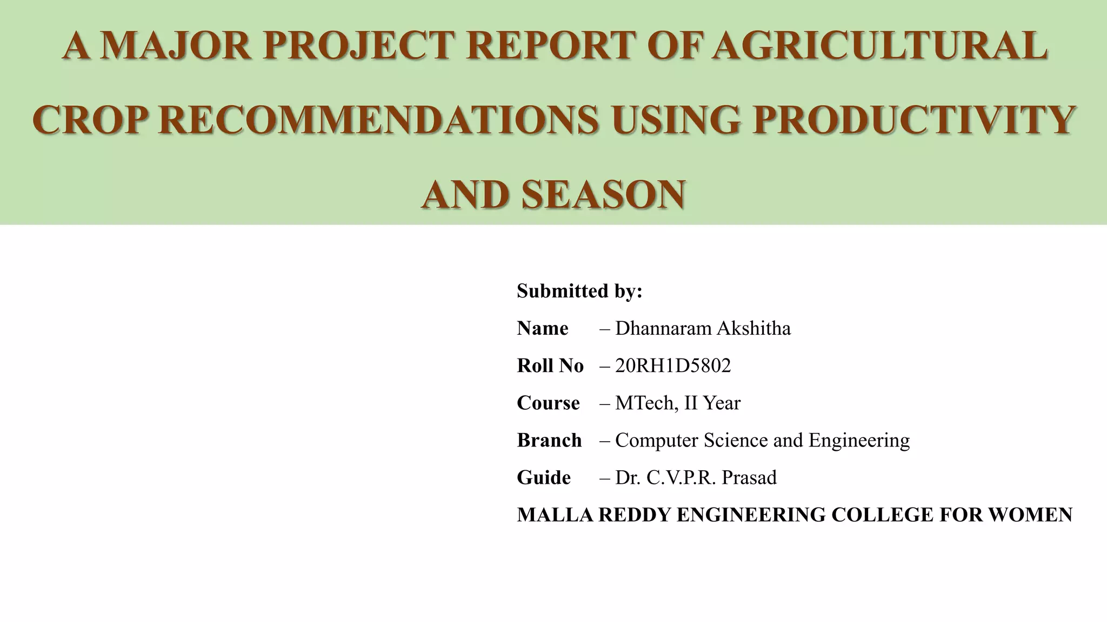
PROJECT REPORT OF CRM AUTOMATION TESTING
NAME : Homa Nazni
Barshana Mustaffa
BRANCH : MCA 4th Semester
PROJECT NAME : CRM AUTOMATION TESTING
GUIDED BY : Prof. Damodar Nayak
Rourkela Institute of Management Studies

Slide 2
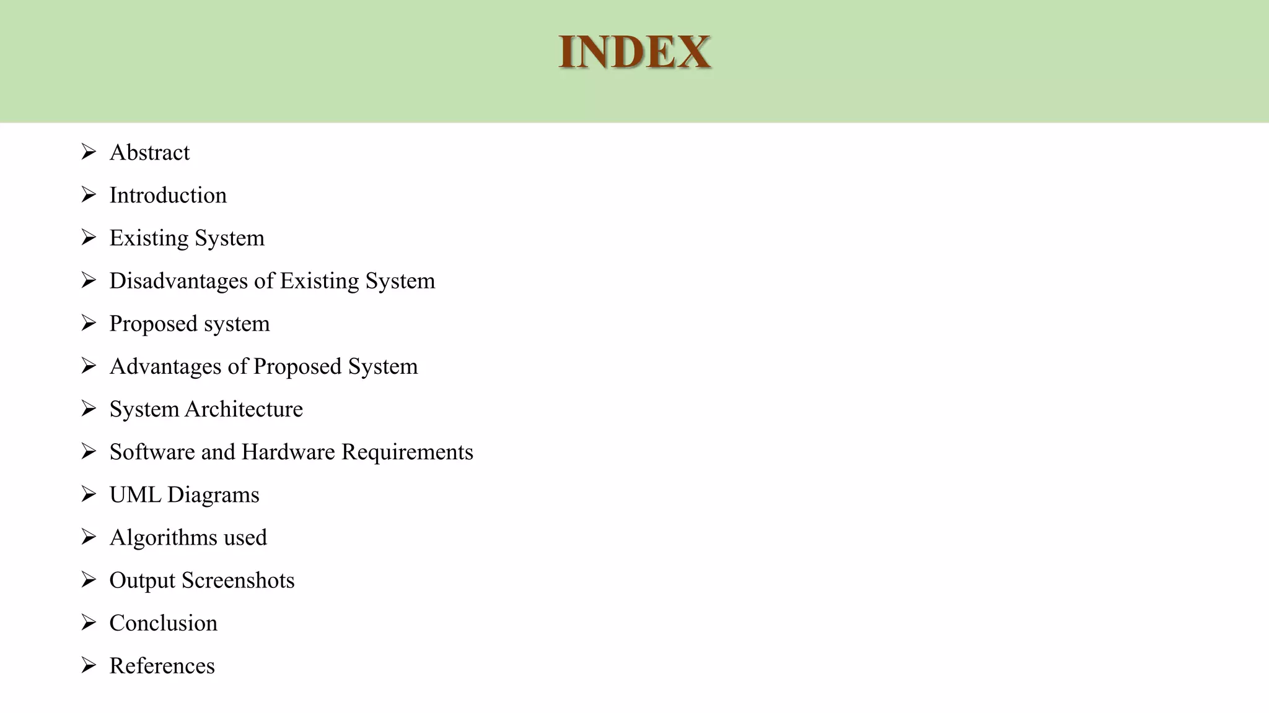
INDEX
Introduction
Issues Without Using CRM Automation Testing
Objectives
Methodology
Tools Used
Test Cases
Advantages
CRM System Architecture
Hardware And Software Requirements
UML Diagrams
Usecase Diagram
Class Diagram
Sequence Diagram
Activity Diagram
Algorithm Used
Conclusion

Slide 3

INTRODUCTION
INTRODUCTION
Welcome to our Customer Relationship Management (CRM) automation testing project. We're here to talk about making CRM systems work better and smoother using smart testing methods.
In today's busy business world, CRM systems help companies keep track of customers and boost sales. But sometimes, these systems can get complicated, and things might not work as they should.
That's where our project comes in. We're using smart tools and methods to test CRM systems better and faster. This means we're making sure everything works well and that customer data is safe and correct
We're using special tools like Selenium and Jenkins to help us do tests quickly and accurately. By doing this, we're saving time and making sure CRM systems are doing what they're supposed to do.
We're using special tools like Selenium and Jenkins to help us do tests quickly and accurately. By doing this, we're saving time and making sure CRM systems are doing what they're supposed to do.
Our goal is to make CRM systems run smoothly and help businesses serve their customers even better. So, join us as we work to make CRM testing easier and more effective.

Slide 4
Issues Without Using
CRM Automation Testing
Human Error: Without automation, there's a higher risk of human errors during manual testing, such as typos, incorrect data entry, or oversight, leading to inaccurate results.
Time Constraints: Manual testing is time-consuming, requiring testers to execute each test case manually, which can result in delays in project timelines and hinder timely releases.
Limited Coverage: Manual testing may not cover all possible scenarios due to time limitations and human constraints, leading to gaps in test coverage and potential issues being overlooked.
Repetitive Tasks: Testers often find themselves repeating the same test cases for each release, which can lead to boredom, fatigue, and overlooking critical issues due to lack of variation.
Inconsistency: Manual testing can result in inconsistent testing approaches and interpretations among different testers, leading to varying test results and outcomes, making it difficult to ensure uniform quality across releases.

Slide 5
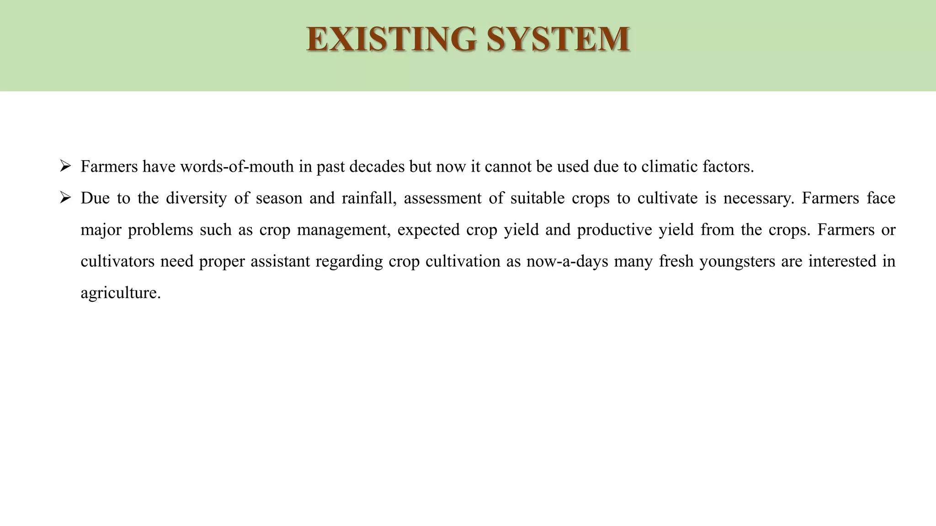
OBJECTIVES
Our CRM automation testing project has some important goals. Here's what we're aiming to achieve:
Make sure everything works: We want to check that all parts of the CRM system are doing what they're supposed to do. This means making sure buttons click, forms submit, and data gets saved correctly.
Keep data safe: Customer data is really important. We're testing to make sure it's kept safe and doesn't get lost or mixed up.
Make things easier for users: We're looking to improve how easy it is for people to use the CRM system. This means making sure it's simple to find information and do tasks without any confusion.
Avoid problems: By testing everything thoroughly, we're aiming to catch any issues before they become big problems. This helps companies save time and avoid headaches down the road.
Build trust: When CRM systems work well, businesses can trust them to do their job. Our testing helps build confidence in the system's reliability and performance.

Slide 6
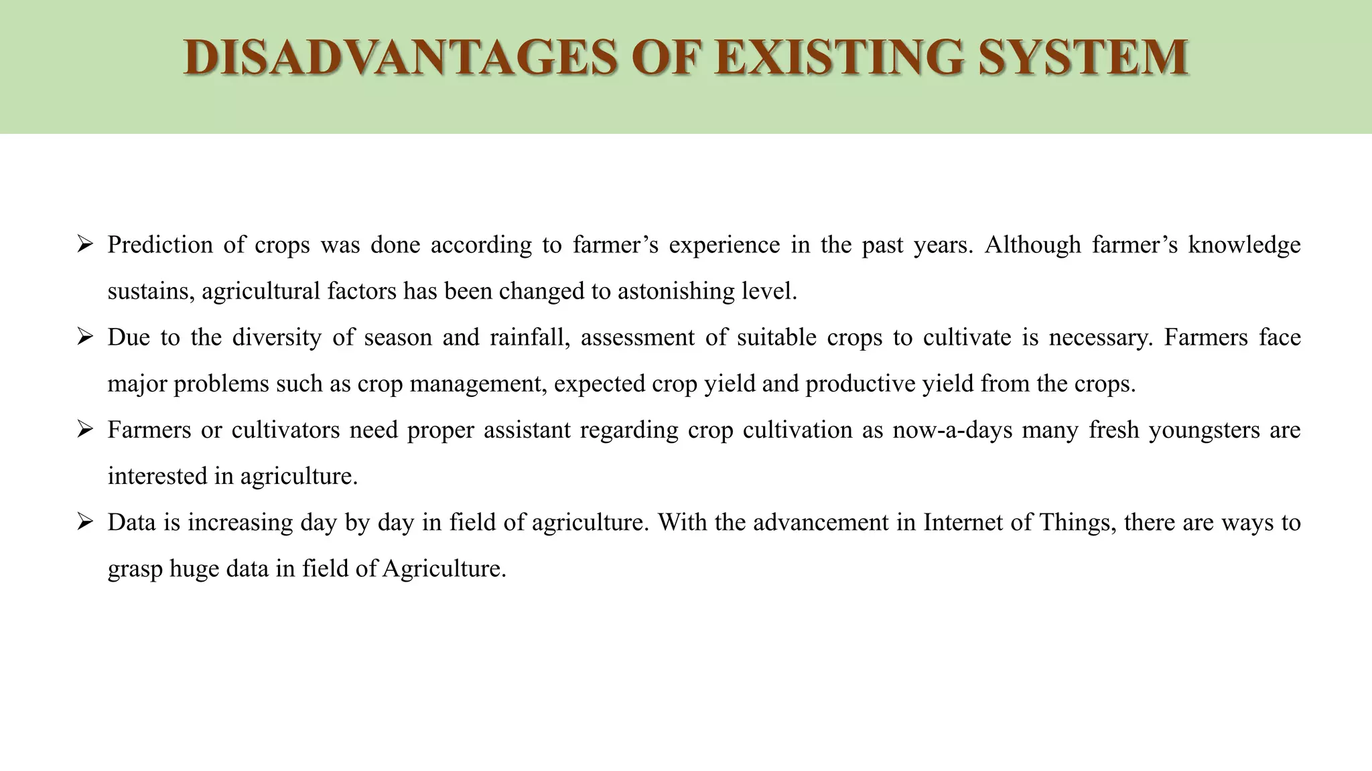
METHODOLOGY
METHODOLOGY
In our CRM automation testing project, we follow a method called Agile. Here's what that means:
Teamwork: We work closely together in small teams. This helps us communicate better and solve problems faster.
Flexibility: We're able to adapt to changes quickly. If something needs to be tested differently ,we can adjust our plans easily.
Feedback: We get feedback often from everyone involved. This helps us know if we're heading in the right direction and if there are any issues we need to fix.
Iterations: We break our work into small parts called iterations. Each iteration is like a mini-project, where we plan, test, and get feedback.
Continuous Improvement: We're always looking for ways to do things better. After each iteration, we review what went well and what we can improve for next time.
By using Agile, we're able to work efficiently, stay flexible, and deliver high-quality results. It helps us tackle challenges head-on and ensure that our CRM testing project stays on track to meet its objectives.

Slide 7
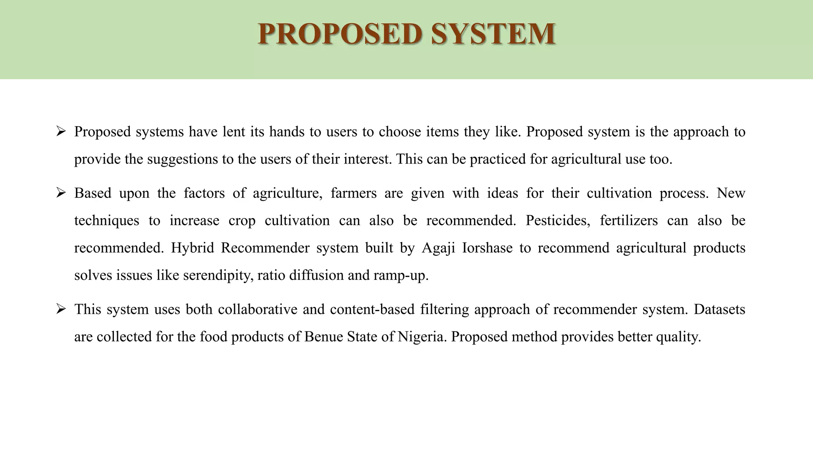
TOOLS USED
In our CRM automation testing project, we use special tools to help us do our job better. Here are some of the tools we rely on:
Selenium: This tool helps us test web applications. It lets us automate tasks like clicking buttons and filling out forms, making testing faster and more accurate.
Appium: Appium is used for testing mobile applications. It helps us ensure that CRM systems work well on different types of mobile devices.
JIRA: JIRA helps us keep track of our testing tasks and any issues we find. It's like a to-do list that helps us stay organized.
Jenkins: Jenkins is a tool for continuous integration and continuous delivery. It helps us automate the process of testing and deploying changes to the CRM system, saving time and effort.
With these tools, we're able to automate testing tasks, manage our work efficiently, and ensure that CRM systems are reliable and user-friendly.

Slide 8
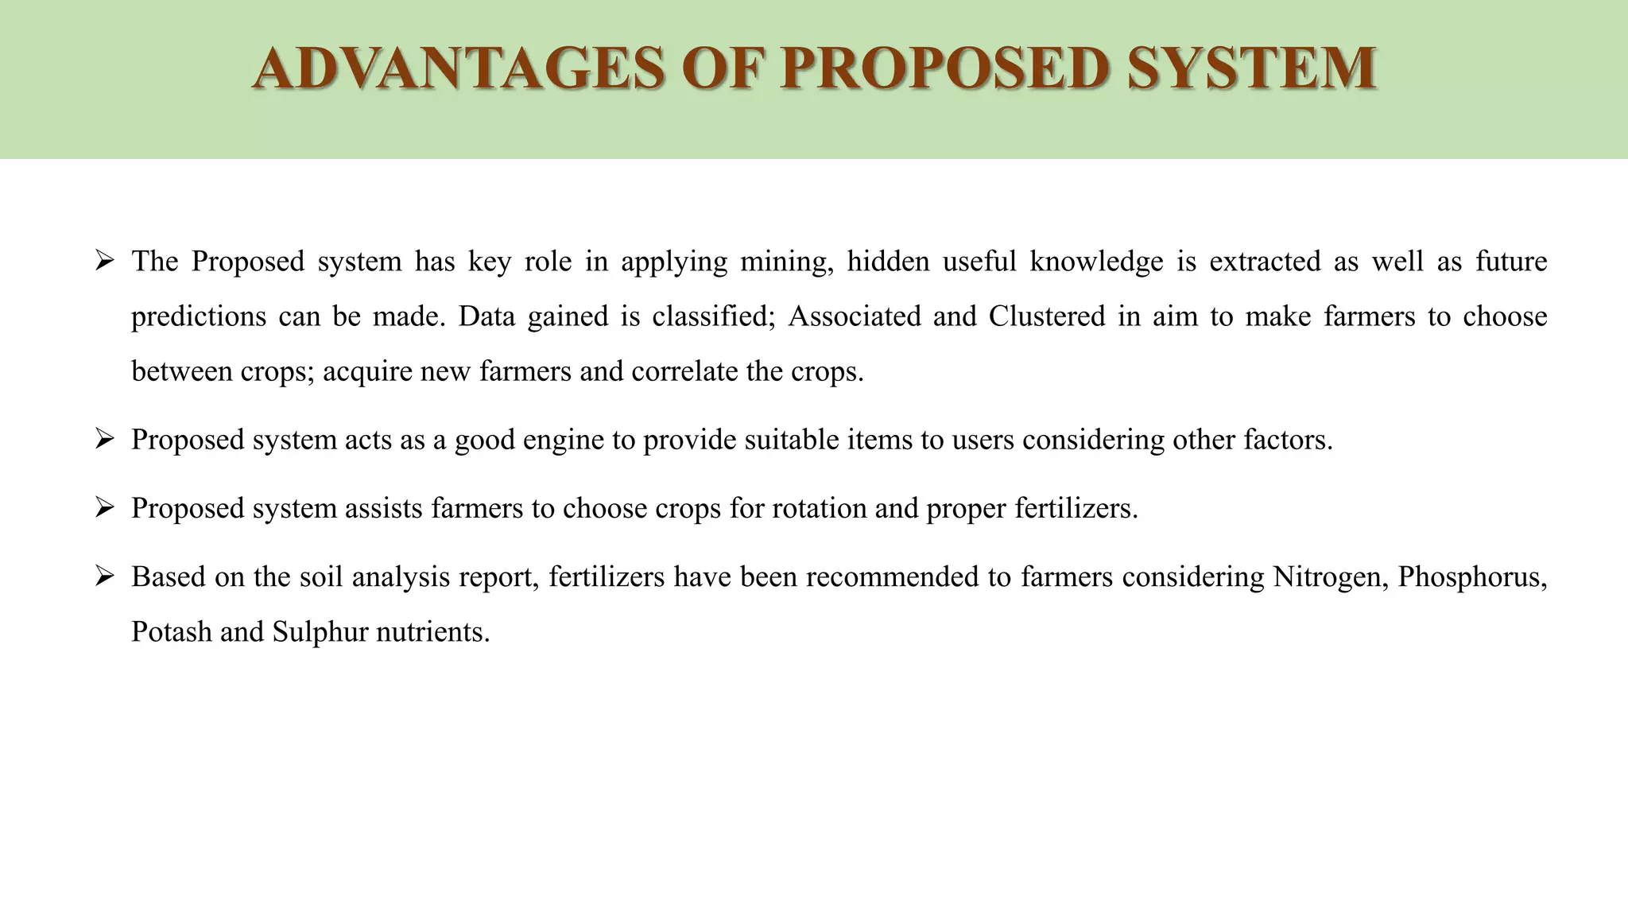
TESTCASES
In our CRM automation testing project, we use different types of test cases to make sure everything works smoothly. Here are the main types:
1.Functional Testing: This type of testing checks if each part of the CRM system works as expected. For example, we test if buttons click, forms submit, and data is saved correctly.
2. Regression Testing: Regression testing helps us make sure that new changes to the CRM system don't break things that used to work. We test to ensure that previous functionalities are still intact after updates or modifications.
3. Performance Testing: Performance testing checks how well the CRM system performs under different conditions. We test to see how fast it responds to user actions and how it handles a large number of users or transactions.
By using these types of test cases, we ensure that the CRM system is functional, reliable, and performs well under various scenarios, providing a positive user experience for all users.

Slide 9
ADVANTAGES
Automating CRM testing offers several advantages that streamline processes and improve overall efficiency:
Time Savings: Automation speeds up testing processes, reducing the time needed to execute test cases and enabling faster releases of CRM updates and features.
Increased Test Coverage: Automation allows for the execution of a larger number of test cases, covering a wider range of scenarios and functionalities within the CRM system.
Consistency: Automated tests are executed consistently, ensuring that each test case is performed identically every time, thereby reducing the risk of human error.
Improved Accuracy: Automated tests produce reliable and repeatable results, minimizing the likelihood of false positives or false negatives in test outcomes.
Cost-Efficiency: While initial setup may require investment, automation ultimately reduces testing costs by minimizing the need for manual labor and resources over time.
.
6.Enhanced Productivity: With repetitive tasks automated, testers can focus on more strategic testing activities, such as exploratory testing and test case design, increasing overall productivity.

Slide 10
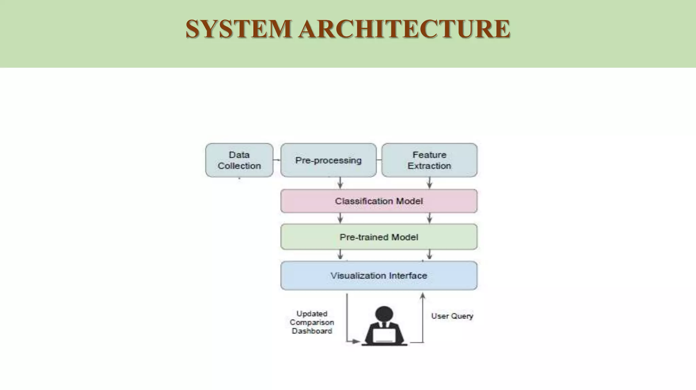
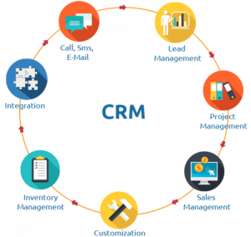
CRM SYSTEM ARCHITECTURE

Slide 11
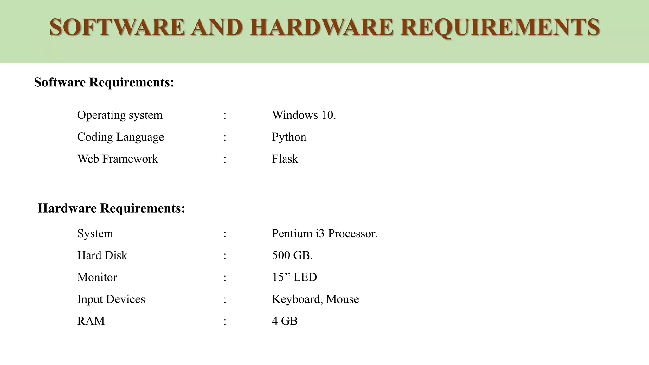
Software And Hardware Requirements
Windows 11
Java

Slide 12
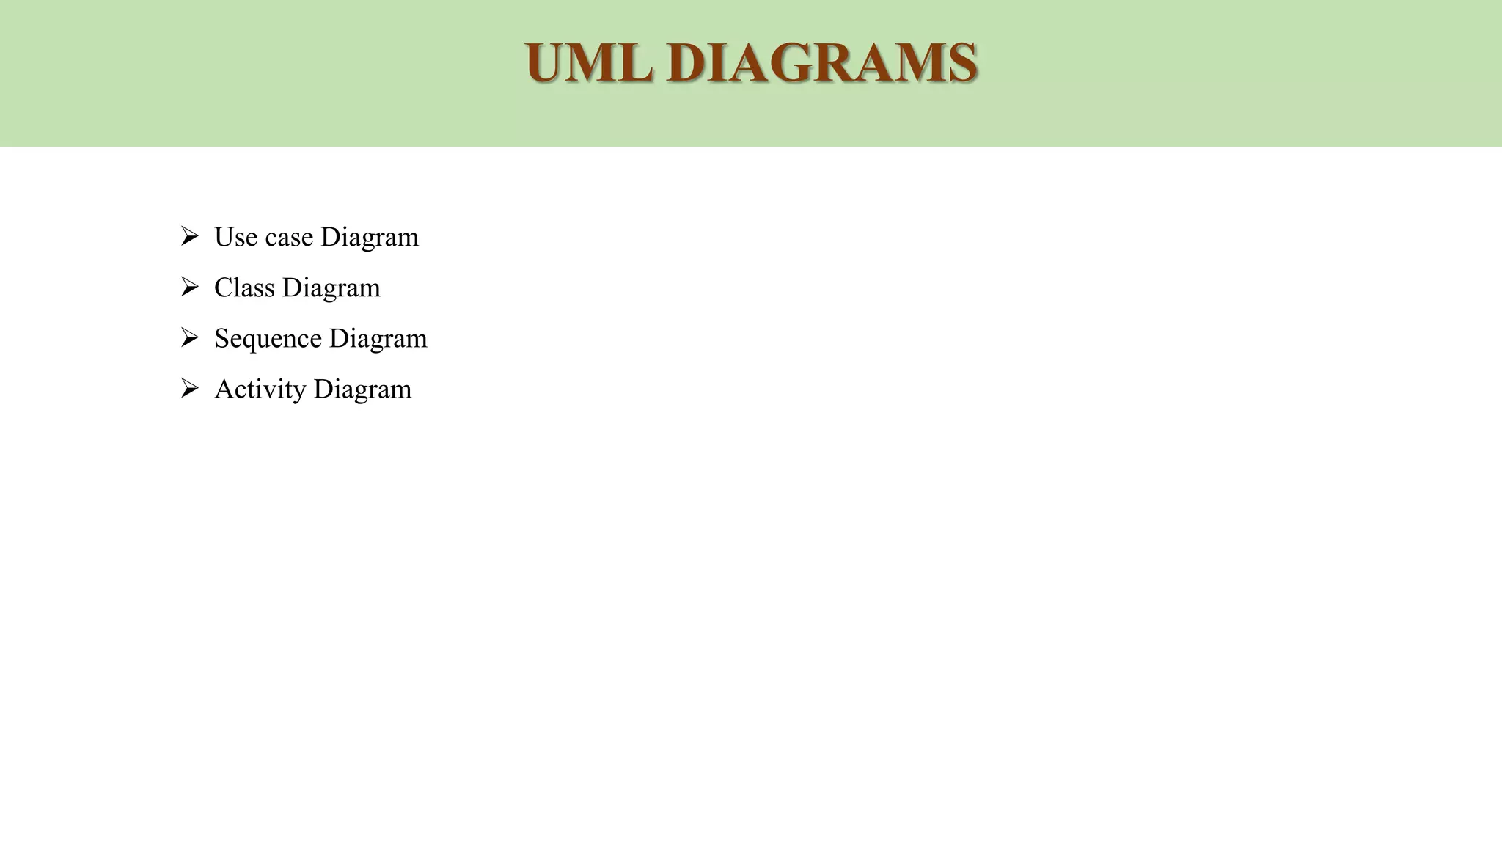
UML DIAGRAMS

Slide 13
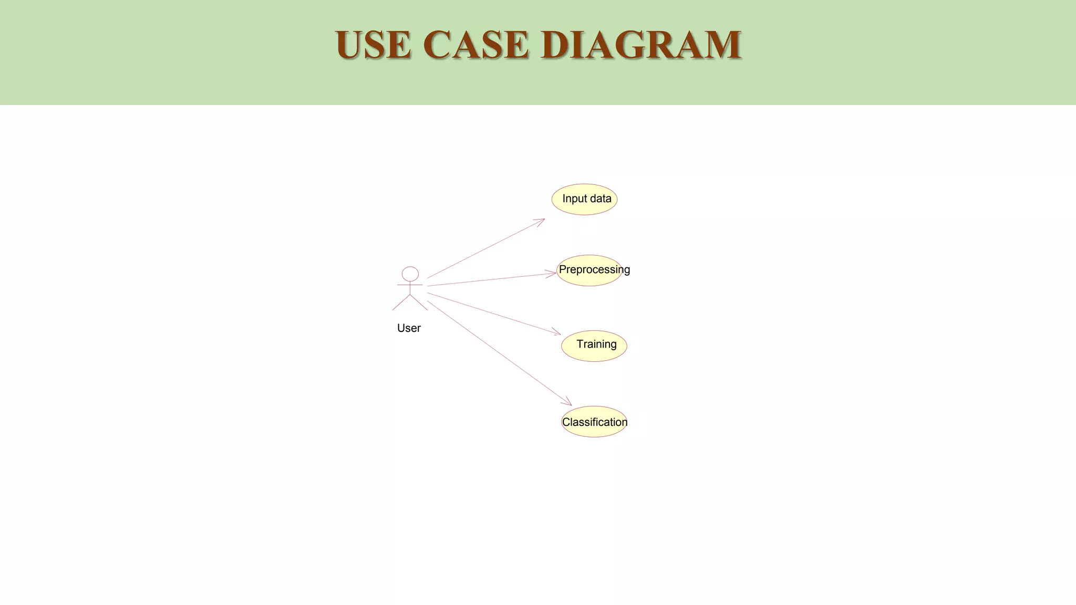
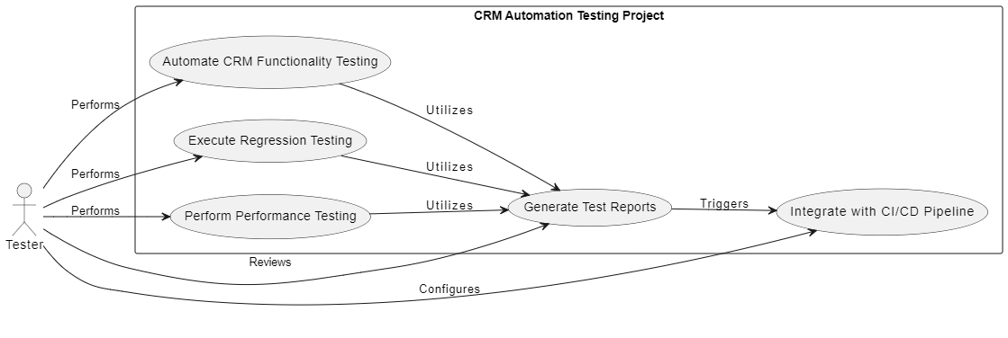
USECASE DIAGRAM
USECASE DIAGRAM

Slide 14
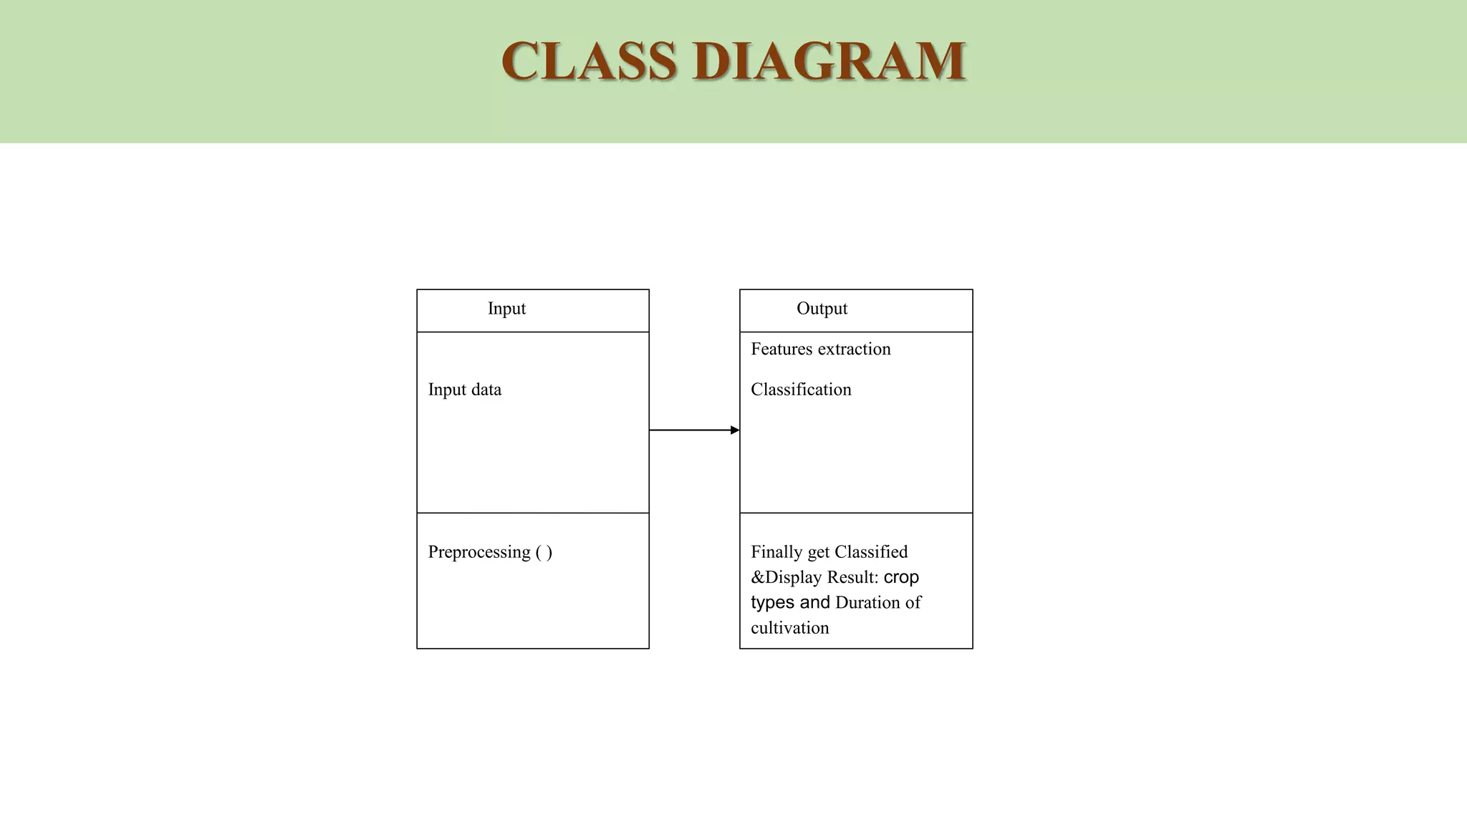
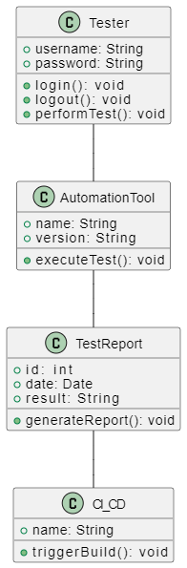
CLASS DIAGRAM
CLASS DIAGRAM
CLASS DIAGRAM

Slide 15
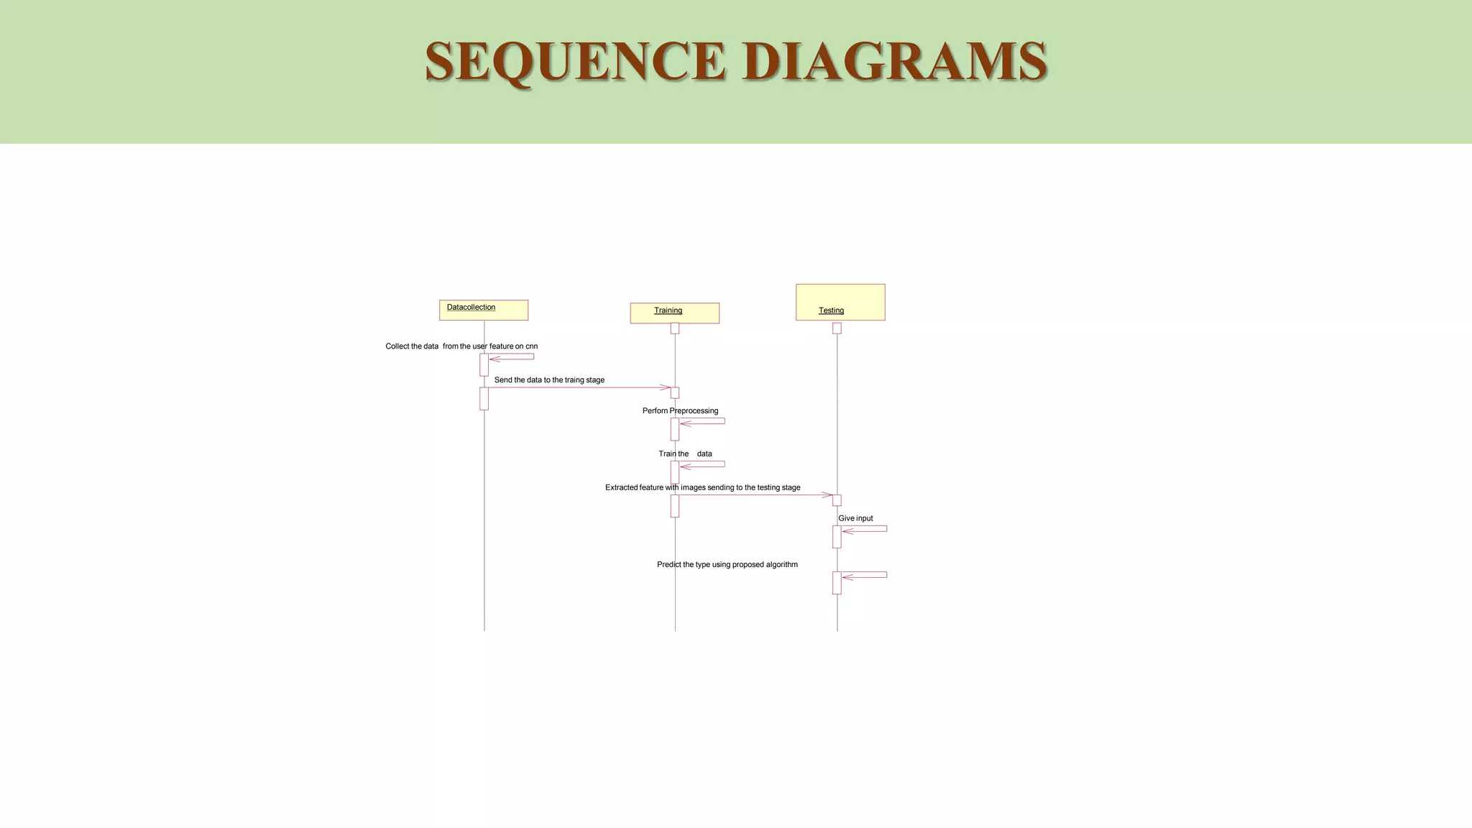
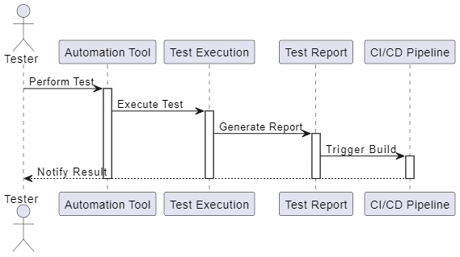
SEQUENCE DIAGRAM
SEQUENCE DIAGRAM

Slide 16
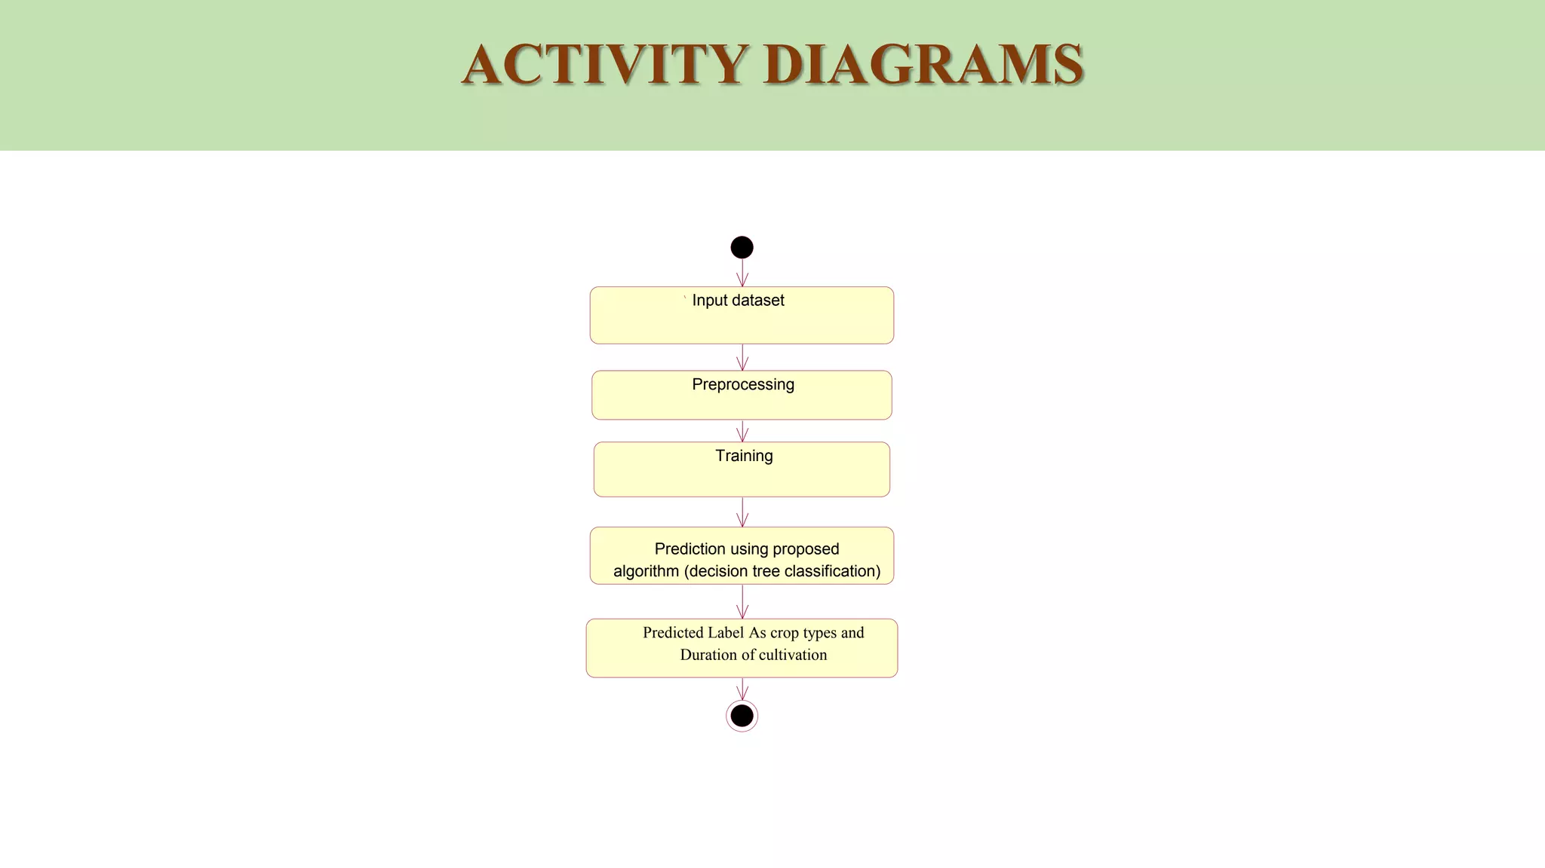
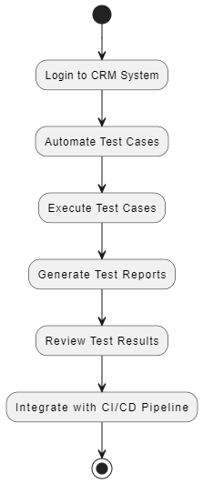
ACTIVITY DIAGRAM

Slide 17
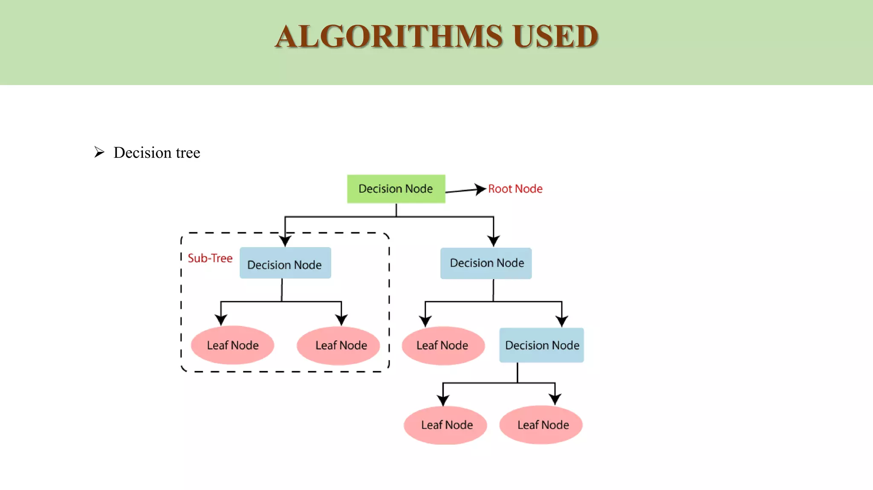
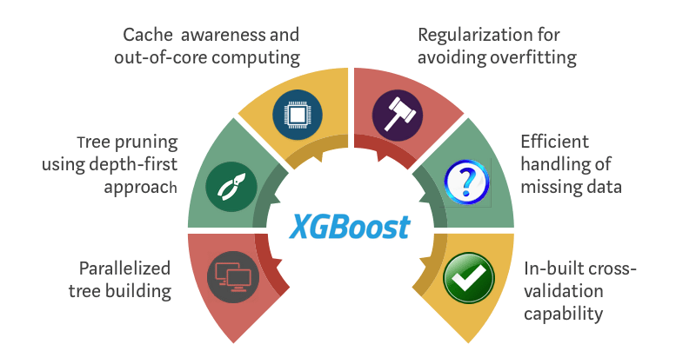
ALGORITHMS USED
Pattern Matching Algorithms
aPattern Matching Algorithms
Data Validation Algorithms
Test Data Generation Algorithms
Statistical Analysis Algorithms
CRM
XPath and CSS Selectors
Machine Learning Algorithms

Slide 18
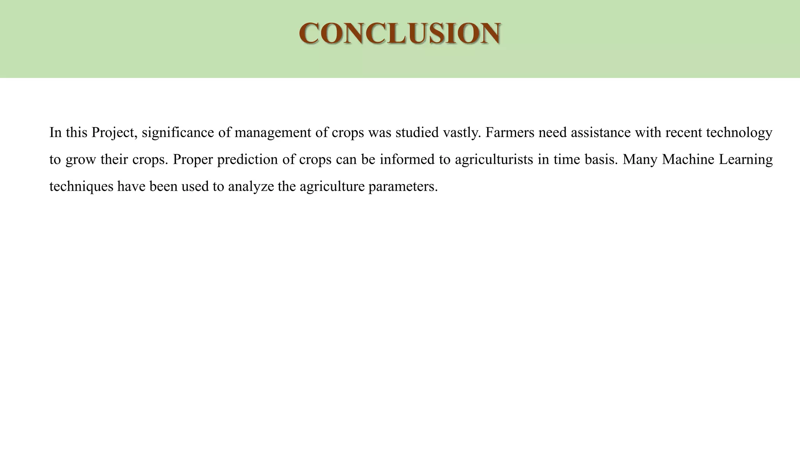
CONCLUSION
In conclusion, CRM automation testing revolutionizes the way we ensure the reliability and effectiveness of CRM systems. By leveraging automation tools and methodologies, we streamline testing processes, increase test coverage, and improve overall efficiency.
This approach not only saves time and reduces costs but also enhances the accuracy and consistency of test results. With faster feedback and increased productivity, CRM automation testing enables us to deliver high-quality CRM solutions that meet the evolving needs of businesses and customers.
Embracing automation in CRM testing is not just a choice but a necessity in today's competitive landscape, ensuring superior performance and customer satisfaction.

